Slide 1
Pitch Deck
FPV Life
Making our cities safer through autonomous drones
Keshav Sharma | Keshav.simple.123@gmail.com | Developer
Notes:
Hello everyone, my name is Keshav Sharma. I’m the founder of FPV Life.

Slide 2
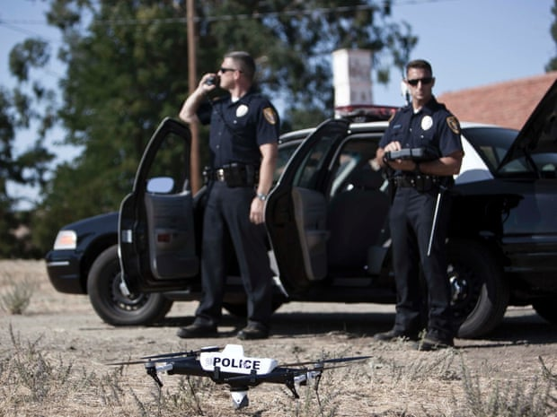
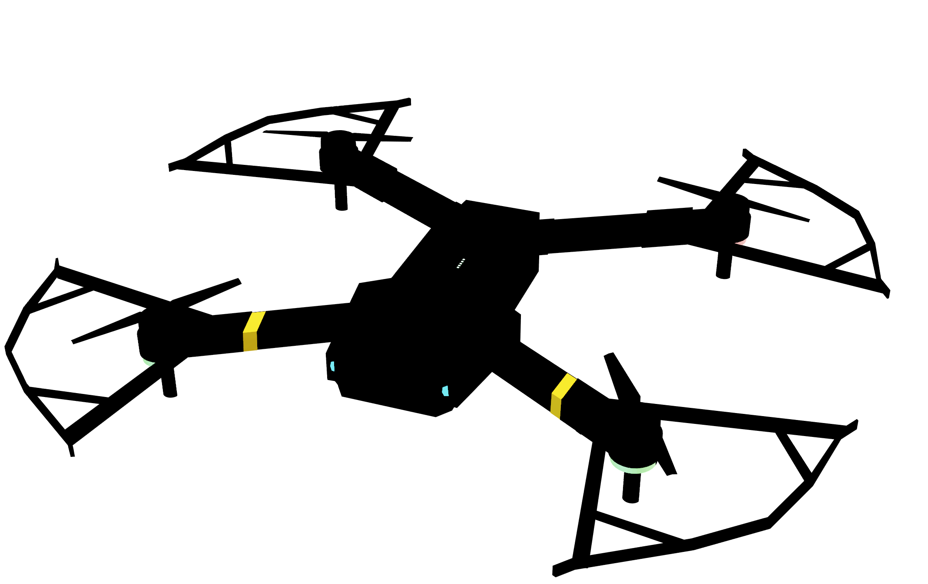
FPV Life
Autonomous drones for Police Patrolling
Notes:
Are you frustrated by the growing crime rate and car accidents?

Slide 3
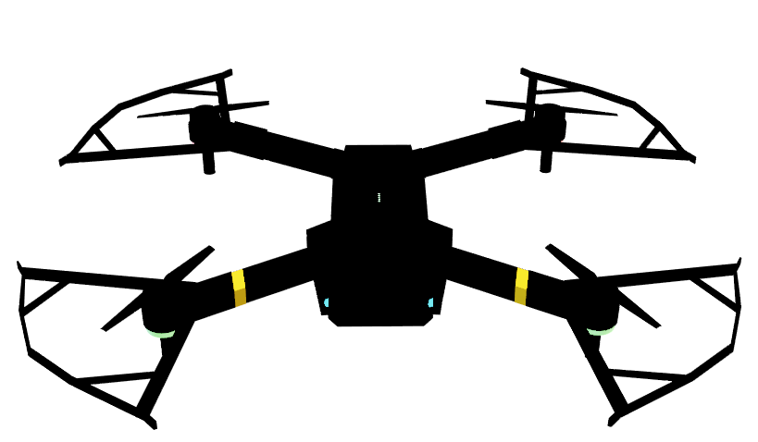
FPV Life
PROBLEM
Autonomous drones for Police Patrolling
Crowded places have a surveillance problem
Traditional surveillance methods are limited in their capabilities and fail to provide real-time insights, leading to delayed response and loss of crucial evidence.
Increasing instances of theft, shoplifting, burglary, and other criminal activities demand an innovative and advanced solution for effective and efficient law enforcement.
Notes:
Have you ever been travelling to a new city and got stuck in a traffic jam and wondered why there is such a huge jam or a car just got stolen and you want to investigate how or who stole it?

Slide 4
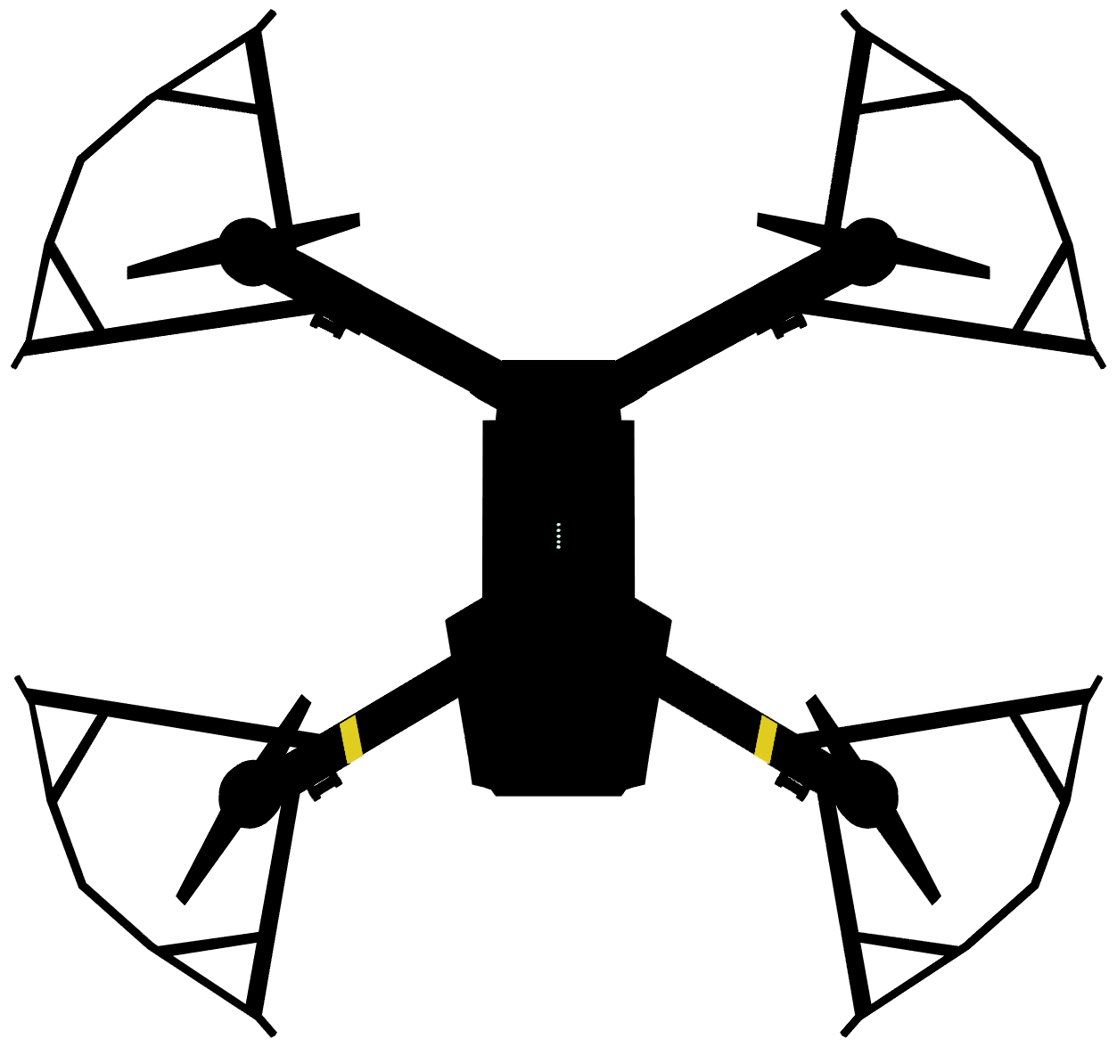
FPV Life
SOLUTION
Autonomous drones for Police Patrolling
Fully Autonomous Drones
Combination of hardware + Software
That fly on their own.
Can inspect large area.
Does not require any human input for control.
Notes:
Well, then look no further, because our startup FPV Life is revolutionizing how cities are monitored and patrolled. We provide AI-based patrolling systems that police and law enforcement agencies could use to protect our cities and safeguard our nation as a whole.

Slide 5
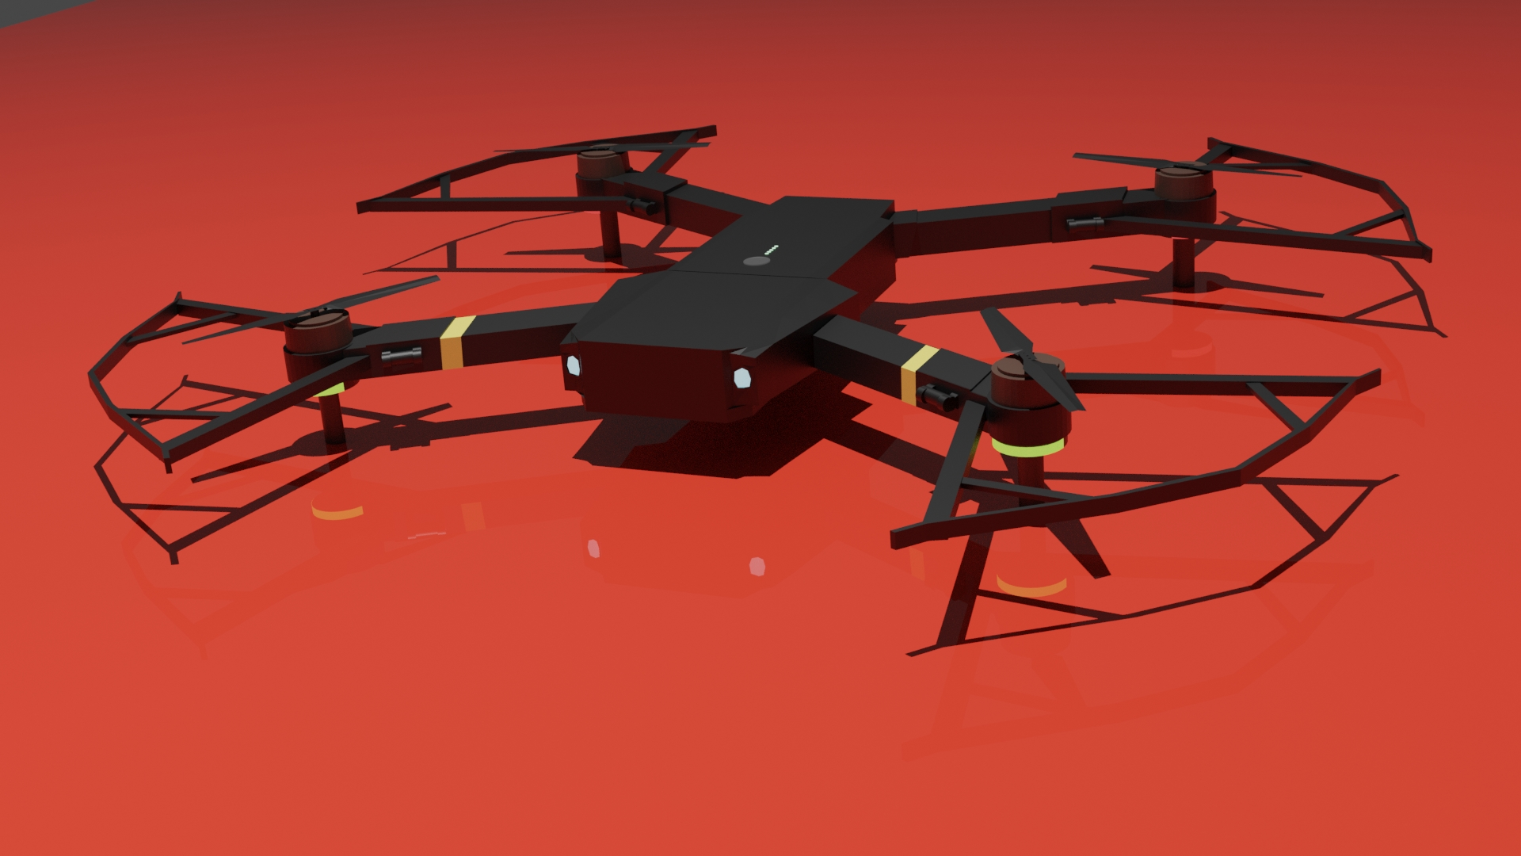
Notes:
This is how our drones will look like when we’ll get the funding..

Slide 6
Our Customers
Police
Law Enforcement Agencies
Government
Military
Event companies
Notes:
These are our customers we are targeting.

Slide 7
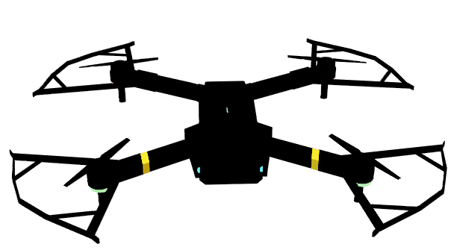
FPV Life
INDUSTRIES
Autonomous drones for Police Patrolling
AI / ML
Deep Tech
IoT
Security
Notes:
These are the industries that we relate to.

Slide 8

Not
Just
Hardware
But
Software
As Well
Notes:
So what are we offering? Not just hardware, but software as well.

Slide 9
Introducing Drone as a Platform
Welcome to the new model of drones that have never been seen before.
We introduce to you Drones as a Platform interface:
For third-party developers to use our hardware and build software and experiences on top of it.
This will allow us to capture the value already created and create additional revenue stream:
Software subscriptions
Service fees
Data sales
Notes:
Introducing Drones as a platform. To capture more value from our hardware, we are building them into platforms, where third-party developers get a chance to make software that runs on our hardware…

Slide 10
As Revolutionary as the smartphone
These drones are much more capable than a smartphone.
They are able to just as productive and communicative as the revolutionary smartphones.
Software subscriptions
Service fees
Data sales
Notes:
much like we have play store on Android and app store on Apple iPhones.

Slide 11
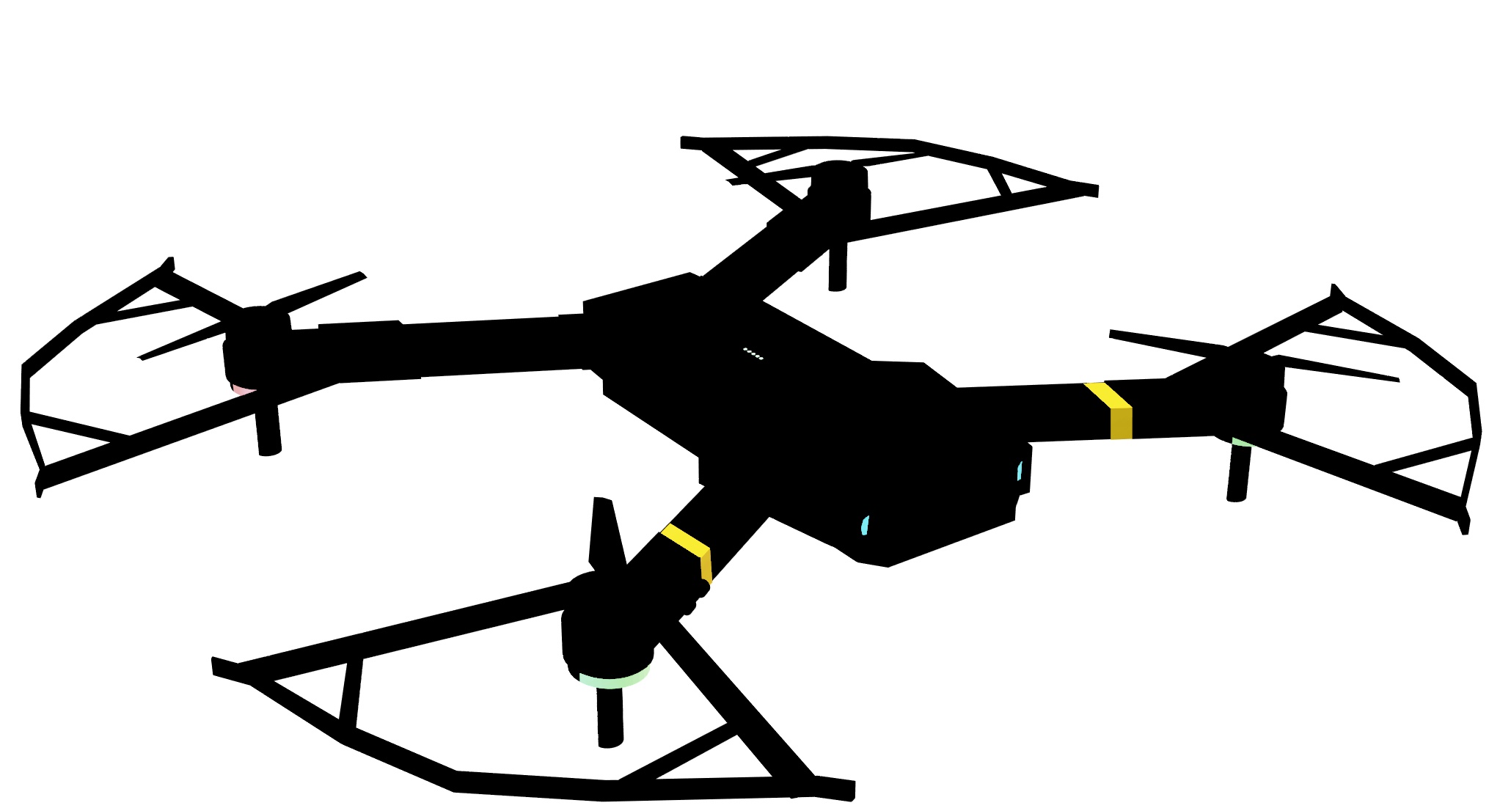

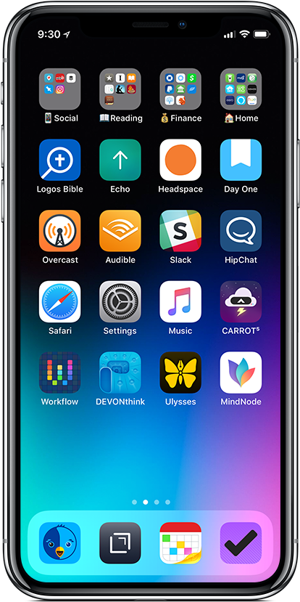
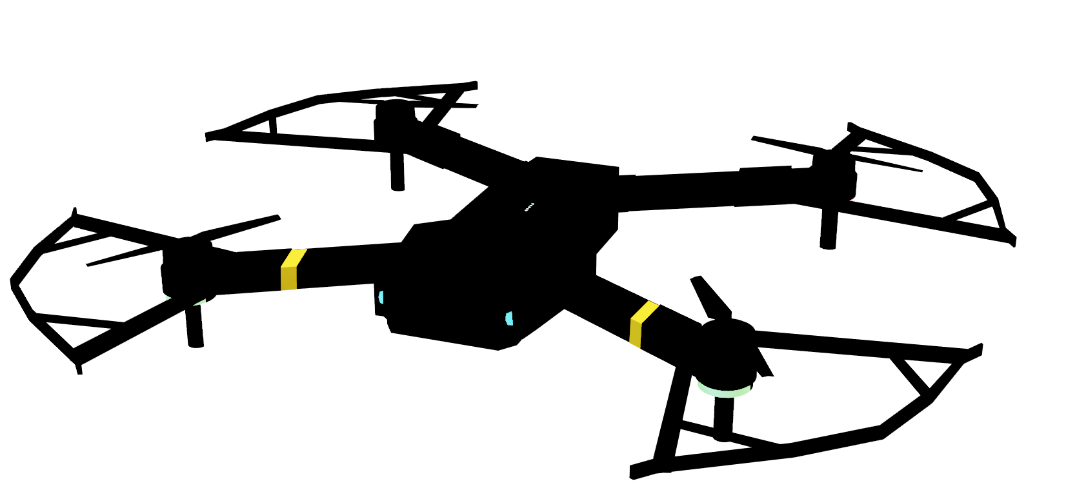
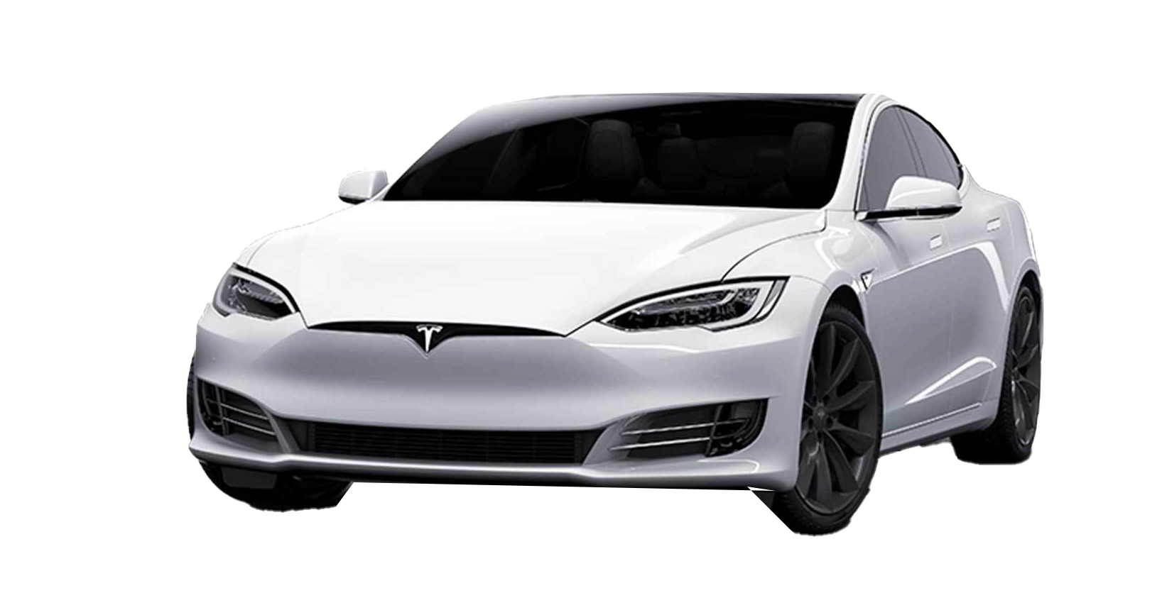
FPV Life
Apple iPhone
Autonomous drones for Police Patrolling
Notes:
Could you guess what is common among all these three products?
Yes, they-, are- paltforms.

Slide 12

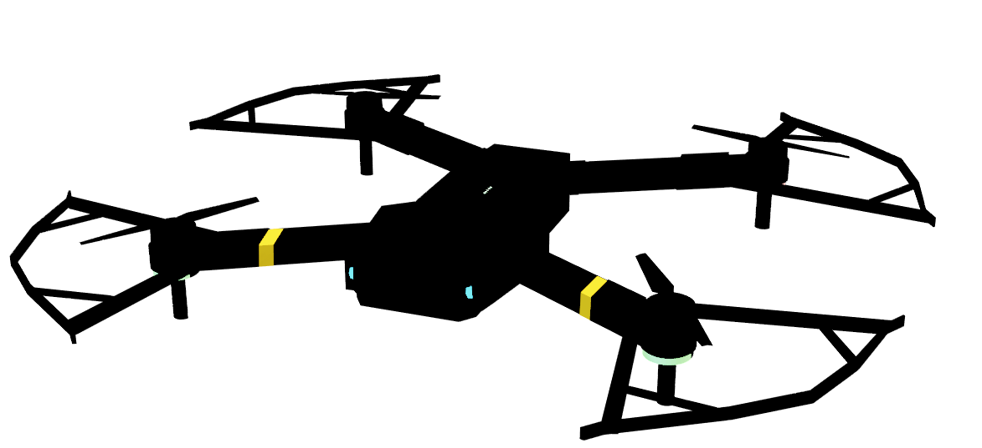
FPV Life
Autonomous drones for Police Patrolling
VS
On-device processing: For better security.
Uses Cameras and Lidar for autonomous flight.
Uses AI / ML for Image and Video Processing: No need to rely on external processers.
Notes:
Here we are comparing self ‘flying’ drones with self ‘driving’ cars. And, you could see they both have almost the same features. * *

Slide 13

Revenue Model
One time cost of purchasing the drone and then every time your power it.
Hardware sales
$1,500 one time by far better than paying for monthly security.
Next:
Software subscriptions
Service fees
Data sales
Notes:
Our revenue model is plain simple. Our customers pay a one-time cost to purchase the drones and then every time they charge it.

Slide 14


Revenue Model
Software subscriptions
We envision drones as to be indifferent to smartphones and so they all require software to operate and an Operating System for enhancing and additional value generation.
Service fees
Data sales

Slide 15
Data sales
Drones create a lot of useful data such as their surroundings, street view, maps, aerial vision, and much more!
We capture these and commercialize them.
Service fees

Slide 16




Slide 17
Competitive Advantages
Autonomous
FPV Life
Skydio
Yuneec
Consumer
Military
DJI
Manual
Notes:
Most of our competitors are mostly US and Chinese.

Slide 18
TAM (Total Addressable Market)
$56.5 billion
According to industry research, the total addressable market for police and government surveillance is estimated to be US$ 15,634.7 million by 2023, with a CAGR of 20.30%.
This market includes the use of drones for surveillance, patrolling, and intelligence gathering purposes. The demand for advanced surveillance solutions is expected to rise due to increasing crime rates and the need for better security measures.
Our target market segment within this TAM is estimated to be $12.05 billion, representing the market size for our AI-based drone solution.

Slide 19
Market Size
The global autonomous drone market is expected to reach a valuation of US$ 15,634.7 million in 2023.
The market is expected to progress at a CAGR of 19.3% to reach US$ 91,304.8 million by the end of 2033.
In 2023, the global drone market is estimated to be valued around US$ 33.9 billion.
Autonomous drone sales accounted for nearly 46% share of the global drone market at the end of 2022.
DJI, Parrot, Yuneec, 3D Robotics Inc., Go Pro, Holy Stone, Autel Robotics, Sense Fly are our competitors.

